Slide 1
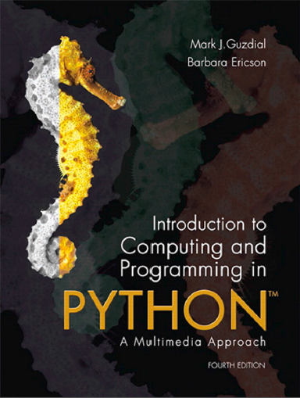
Introduction to Computing and Programming in Python™: A Multimedia Approach
Fourth Edition
Chapter 4
Modifying Pictures Using Loops
Copyright © 2016, 2013, 2010 Pearson Education, Inc. All Rights Reserved
Notes:
If this PowerPoint presentation contains mathematical equations, you may need to check that your computer has the following installed:
1) MathType Plugin
2) Math Player (free versions available)
3) NVDA Reader (free versions available)

Slide 2
Learning Objectives (1 of 2)
4.1 To understand how images are digitized by taking advantage of limits in human vision.
4.2 To identify different models for color, including R G B, the most common one for computers.
4.3 To manipulate color values in pictures, like increasing or decreasing red values.
4.4 To convert a color picture to grayscale, using more than one method.
4.5 To negate a picture.

Slide 3
Learning Objectives (2 of 2)
4.6 To use a matrix representation in finding pixels in a picture.
4.7 To use the objects pictures and pixels.
4.8 To use iteration (with a for loop) for changing the color values of pixels in a picture.
4.9 To nest blocks of code within one another.
4.10 To choose between having a function return a value and just providing a side effect.
4.11 To determine the scope of a variable name.

Slide 4
We Perceive Light Different from How it Actually is
Color is continuous
Visible light is in the wavelengths between 370 and 730 nanometers
That’s 0.00000037 and 0.00000073 meters
But we perceive light with color sensors that peak around 425 newtonmeter (blue), 550 newtonmeter (green), and 560 newtonmeter (red).
Our brain figures out which color is which by figuring out how much of each kind of sensor is responding
One implication: We perceive two kinds of “orange” — one that's spectral and one that’s red + yellow (hits our color sensors just right)
Dogs and other simpler animals have only two kinds of sensors
They do see color. Just less color.

Slide 5
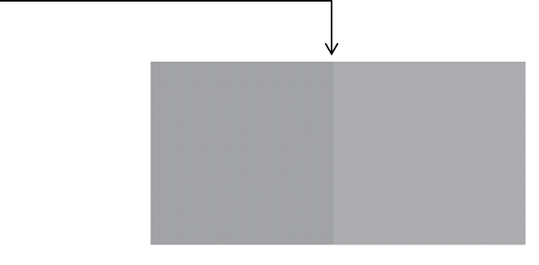
Luminance Vs. Color
We perceive borders of things, motion, depth via luminance
Luminance is not the amount of light, but our perception of the amount of light.
We see blue as “darker” than red, even if same amount of light.
Much of our luminance perception is based on comparison to backgrounds, not raw values.
Luminance is actually color blind. Completely different part of the brain does luminance vs. color.

Slide 6
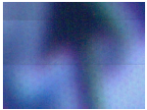
Digitizing Pictures as Bunches of Little Dots
We digitize pictures into lots of little dots
Enough dots and it looks like a continuous whole to our eye
Our eye has limited resolution
Our background/depth acuity is particulary low
Each picture element is referred to as a pixel

Slide 7
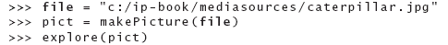
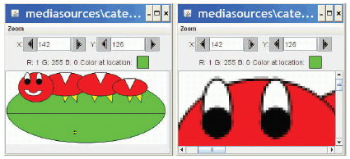
Pixels
Pixels are picture elements
Each pixel object knows its color
It also knows where it is in its picture
When we zoom the picture to 500%, we can see individual pixels.

Slide 8
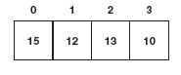
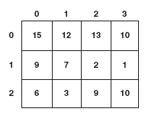
A Picture is a Matrix of Pixels
It’s not a continuous line of elements, that is, an array
A picture has two dimensions: Width and Height
We need a two-dimensional array: a matrix

Slide 9
Referencing a Matrix
We talk about positions in a matrix as (x,y), or (horizontal, vertical)
Element (1,0) in the matrix at left is the value 12
Element (0,2) is 6

Slide 10
Encoding Color
Each pixel encodes color at that position in the picture
Lots of encodings for color
Printers use C M Y K: Cyan, Magenta, Yellow, and blacK.
Others use H S B for Hue, Saturation, and Brightness (also called H S V for Hue, Saturation, and Value)
We’ll use the most common for computers
R G B: Red, Green, Blue
Notes:
CMYK is Cyan, Yellow, Magenta, blacK
HSV is Hue, Saturation, Value. HSB is Hue, Saturation, Brightness

Slide 11
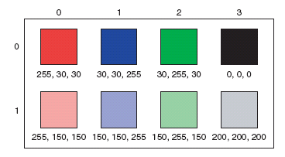
Encoding R G B
Each component color (red, green, and blue) is encoded as a single byte
Colors go from (0,0,0) to (255,255,255)
If all three components are the same, the color is in greyscale
(200,200,200) at (3,1)
(0,0,0) (at position (3,0) in example) is black
(255,255,255) is white

Slide 12
How Much Can We Encode in 8 Bits?
Let’s walk it through.
If we have one bit, we can represent two patterns: 0 and 1.
If we have two bits, we can represent four patterns:
If we have three bits, we can represent eight patterns:
patterns
In 8 bits, we can have
General rule: In n bits, we can have
patterns, or 256
If we make one pattern 0, then the highest value we can represent is
or 255

Slide 13
Is That Enough?
We’re representing color in
bits.
That’s
possible colors
Our eye can discern millions of colors, so it’s probably pretty close
But the real limitation is the physical devices: We don’t get 16 million colors out of a monitor
Some graphics systems support 32 bits per pixel
May be more pixels for color, or an additional 8 bits to represent 256 levels of translucence

Slide 14
Size of Images
Blank | 320 x 240 image | 640 x 480 image | 1024 x 768 monitor
24 bit color | 230,400 bytes | 921,600 bytes | 2,359,296 bytes
32 bit color | 307,200 bytes | 1,228,800 bytes | 3,145,728 bytes

Slide 15
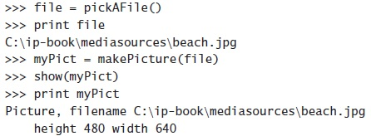
Reminder: Manipulating Pictures

Slide 16
What’s a “Picture”?
An encoding that represents an image
Knows its height and width
Knows its filename
Knows its window if it’s opened (via show and repainted with repaint)

Slide 17
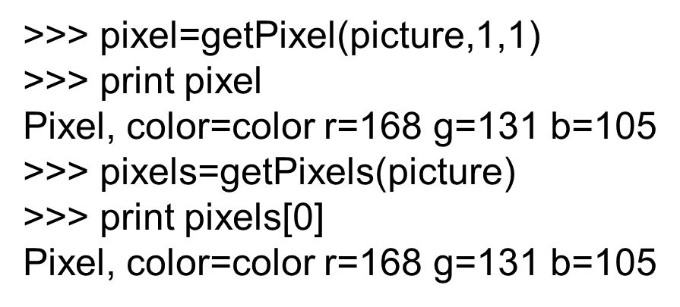
Manipulating Pixels
gets a single pixel.
gets all of them in an array. (Square
brackets is a standard array reference notation—which we’ll generally not use.)

Slide 18
What Can We Do with a Pixel?
getRed, getGreen, and getBlue are functions that take a pixel as input and return a value between 0 and 255
setRed, setGreen, and setBlue are functions that take a pixel as input and a value between 0 and 255

Slide 19
We Can Also Get, Set, and Make Colors
getColor takes a pixel as input and returns a Color object with the color at that pixel
setColor takes a pixel as input and a Color, then sets the pixel to that color
makeColor takes red, green, and blue values (in that order) between 0 and 255, and returns a Color object
pickAColor lets you use a color chooser and returns the chosen color
We also have functions that can makeLighter and makeDarker an input color

Slide 20
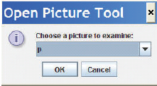
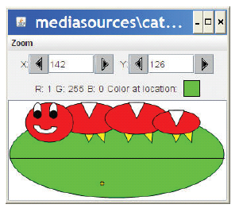
How Do You Find out What R G B Values You Have? And Where? (1 of 2)
Use the MediaTools!
The MediaTools menu knows what variables you have in the Command Area that contain pictures

Slide 21
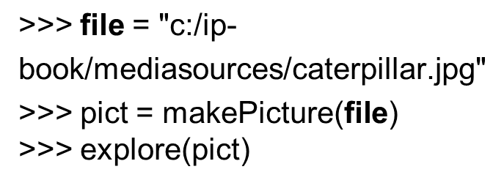
How Do You Find out What R G B Values You Have? And Where? (2 of 2)
Use explore()

Slide 22
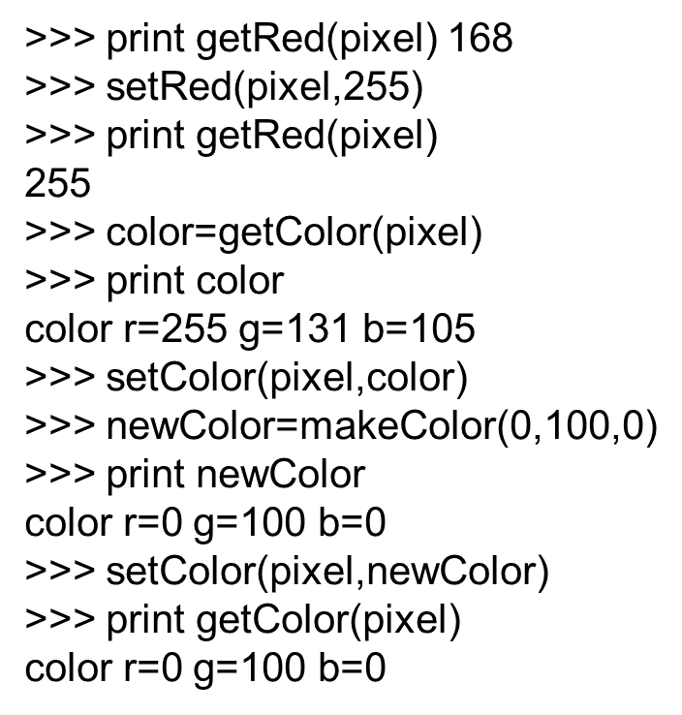
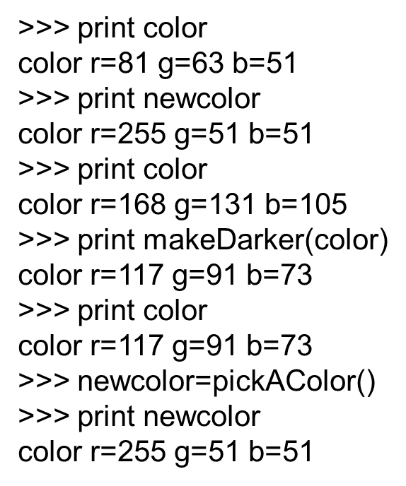
Demonstrating: Manipulating Colors

Slide 23
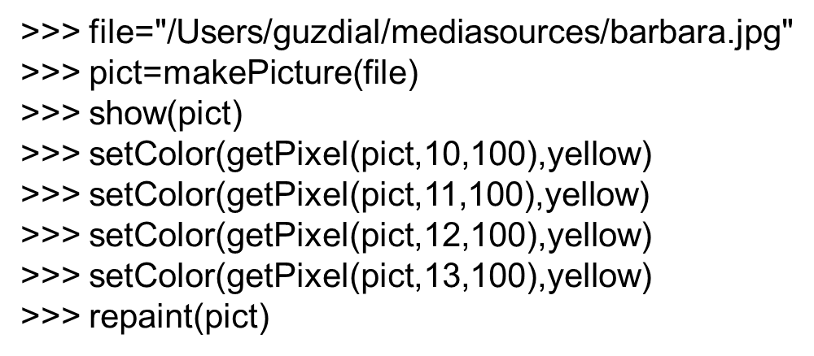
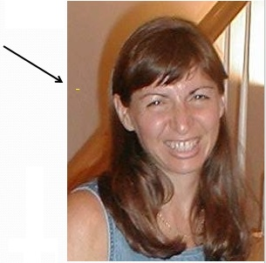
We Can Change Pixels Directly…
But that’s really dull and boring to change each pixel at a time… Isn’t there a better way?

Slide 24
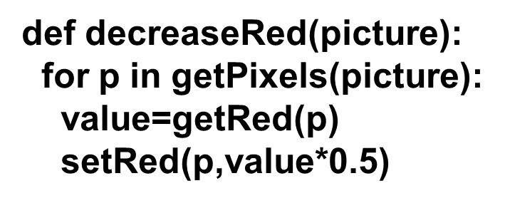
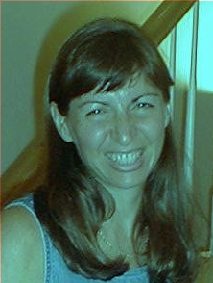
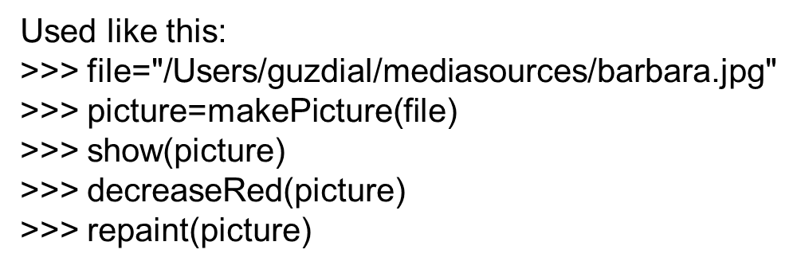
Use a Loop! Our First Picture Recipe

Slide 25
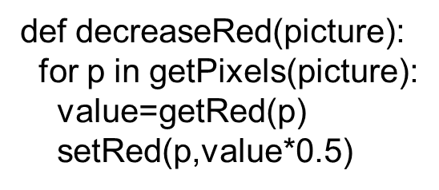
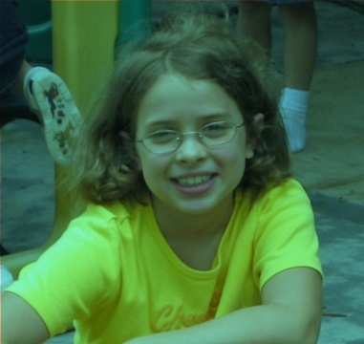
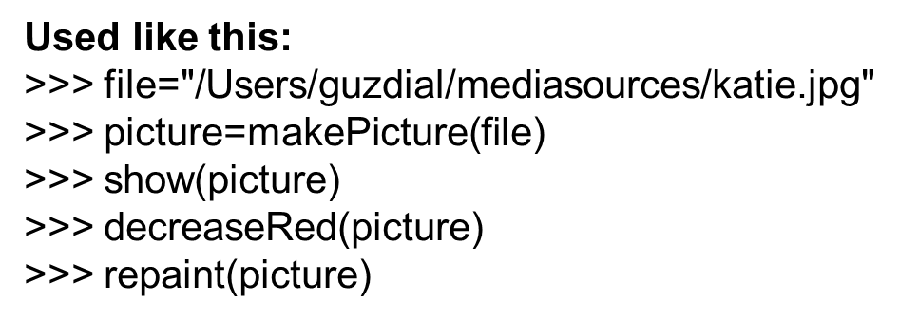
Our First Picture Recipe Works for any Picture

Slide 26
How Do You Make An Omelet?
Something to do with eggs…
What do you do with each of the eggs?
And then what do you do?
All useful recipes involve repetition
Take four eggs and crack them….
Beat the eggs until…
We need these repetition (“iteration”) constructs in computer algorithms too

Slide 27
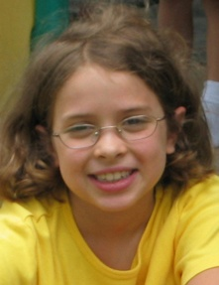
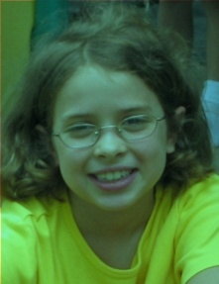
Decreasing the Red in a Picture
Recipe: To decrease the red
Ingredients: One picture, name it pict
Step 1: Get all the pixels of pict. For each pixel p in the set of pixels…
Step 2: Get the value of the red of pixel p, and set it to 50% of its original value

Slide 28
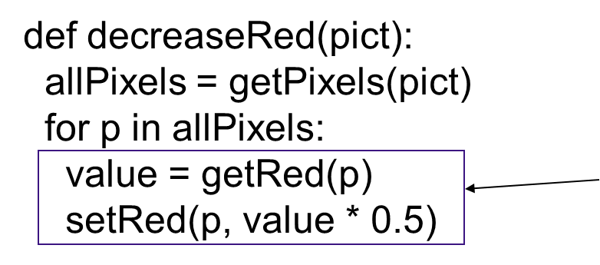
Use a for Loop! Our First Picture Recipe
The loop
- Note the indentation!

Slide 29
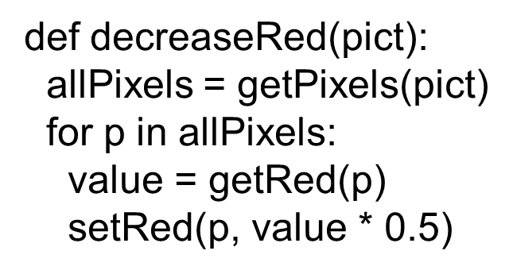
How for Loops are Written
for is the name of the command
An index variable is used to hold each of the different values of a sequence
The word in
A function that generates a sequence
The index variable will be the name for one value in the sequence, each time through the loop
A colon (“:”)
And a block (the indented lines of code)

Slide 30
What Happens When a for Loop is Executed
The index variable is set to an item in the sequence
The block is executed
The variable is often used inside the block
Then execution loops to the for statement, where the index variable gets set to the next item in the sequence
Repeat until every value in the sequence was used.

Slide 31
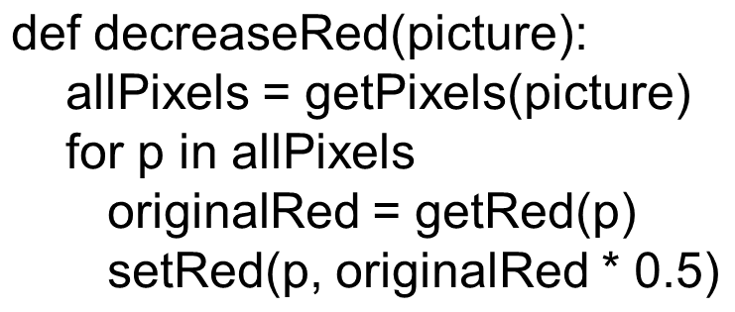
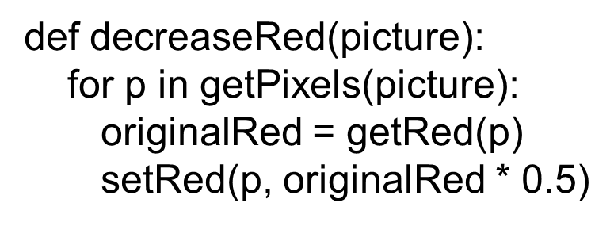
Getpixels Returns a Sequence of Pixels
Each pixel knows its color and place in the original picture
Change the pixel, you change the picture
So the loops here assign the index variable p to each pixel in the picture picture, one at a time.
or equivalently…

Slide 32
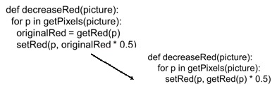
Do We Need the Variable OriginalRed?
No: Having removed allPixels, we can also do without originalRed in the same way:
We can calculate the original red amount right when we are ready to change it.
It’s a matter of programming style. The meanings are the same.

Slide 33
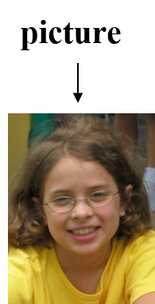
Let’s Walk That through Slowly…
Here we take a picture object in as a parameter to the function and call it picture

Slide 34
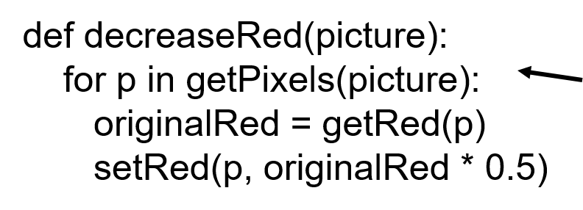
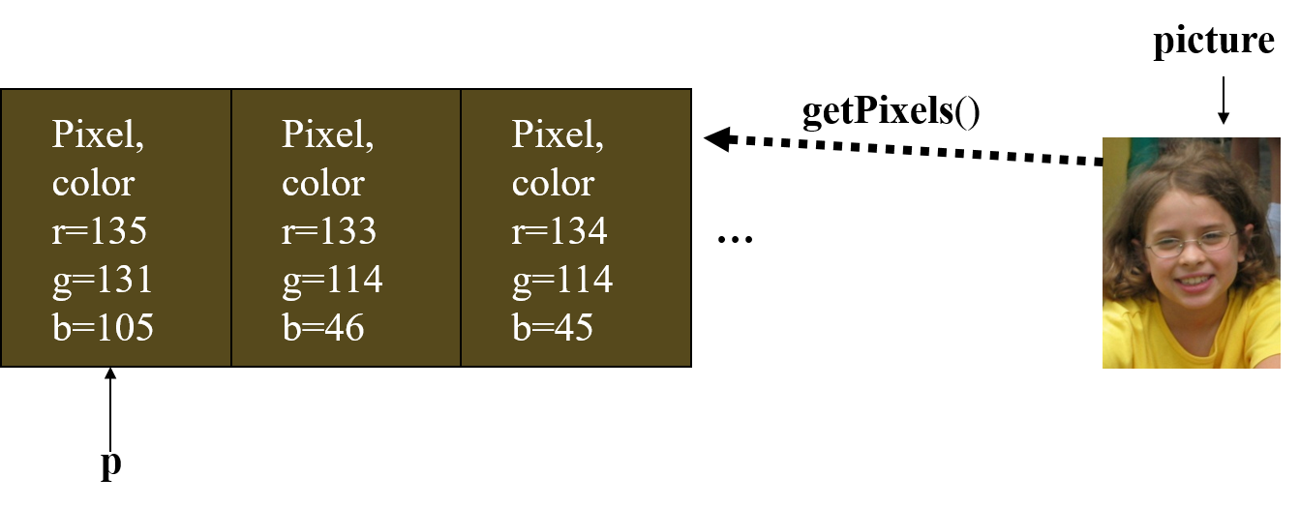
Now, Get the Pixels
We get all the pixels from the picture, then make p be the name of each one at a time

Slide 35
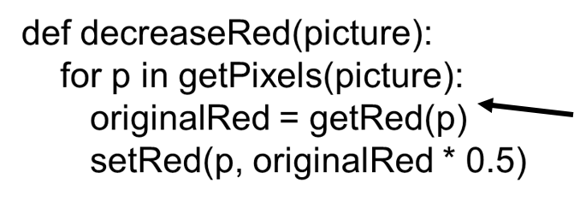
Get the Red Value from Pixel
We get the red value of pixel p and name it originalRed

Slide 36
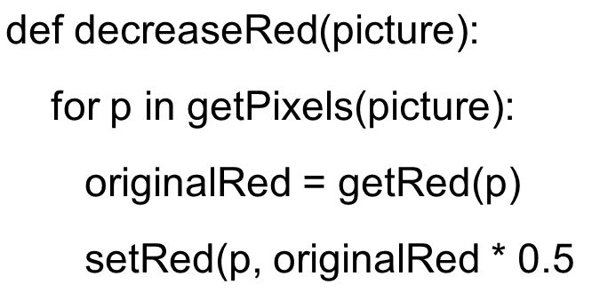
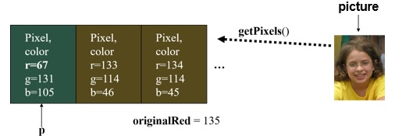
Now Change the Pixel
Set the red value of pixel p to 0.5 (50%) of originalRed

Slide 37
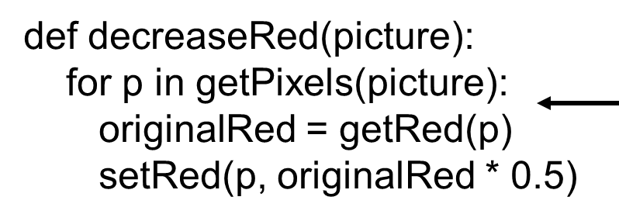
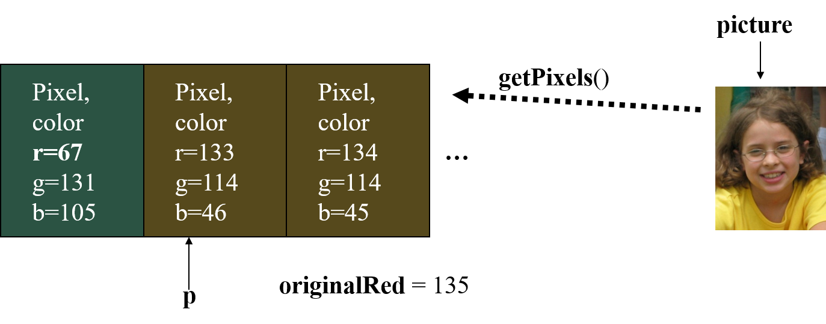
Then Move on to the Next Pixel
Move on to the next pixel and name it p

Slide 38
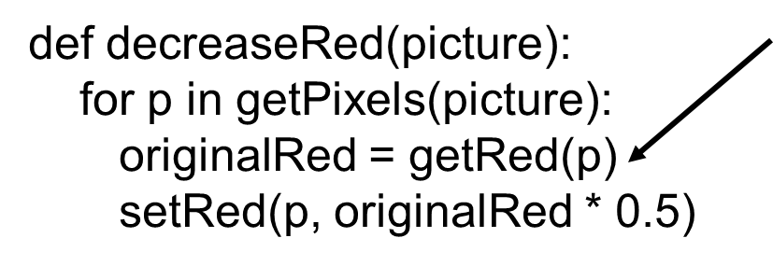
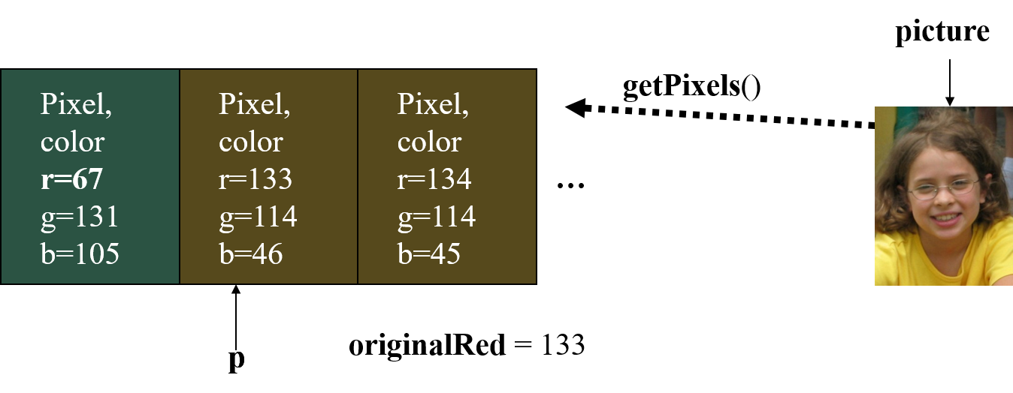
Get Its Red Value
Set originalRed to the red value at the new p, then change the red at that new pixel.

Slide 39
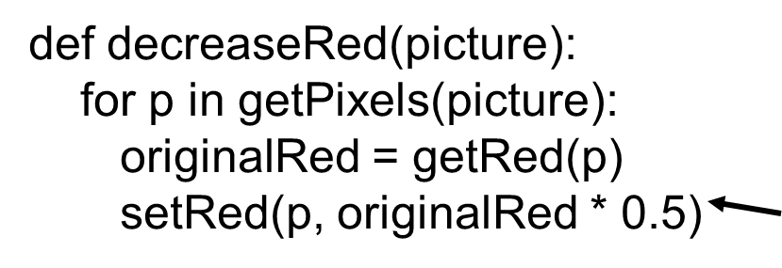
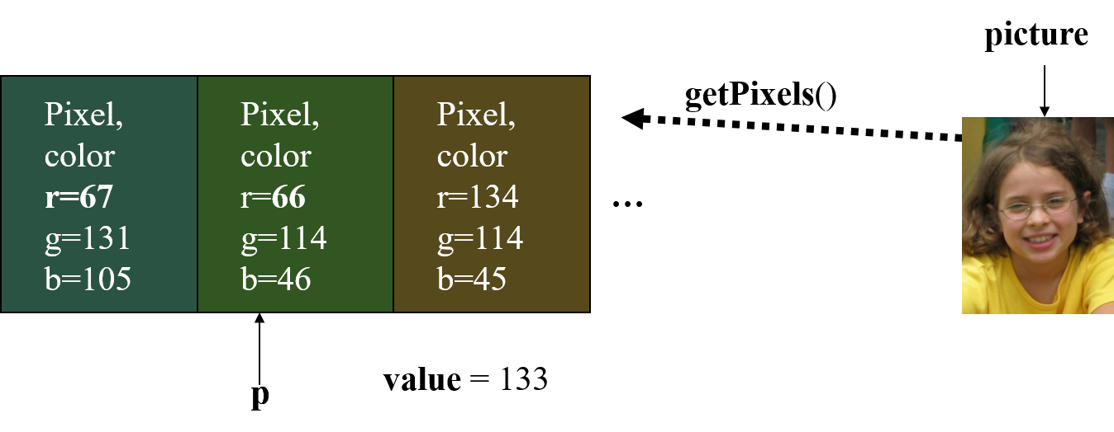
And Change this Red Value
Change the red value at pixel p to 50% of value

Slide 40

And Eventually, We Do All Pixels
We go from this…
to this!

Slide 41
“Tracing/Stepping/Walking Through” the Program
What we just did is called “stepping” or “walking through” the program
You consider each step of the program, in the order that the computer would execute it
You consider what exactly would happen
You write down what values each variable (name) has at each point.
It’s one of the most important debugging skills you can have.
And everyone has to do a lot of debugging, especially at first.

Slide 42

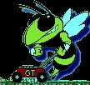
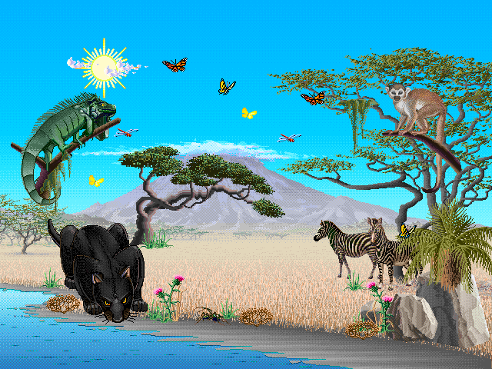
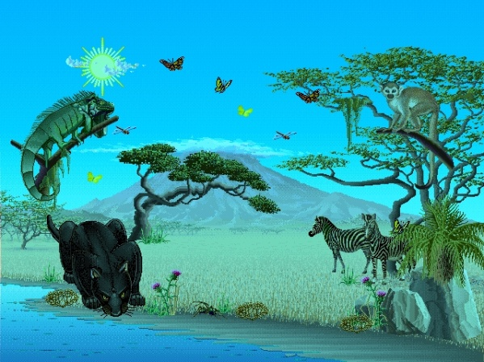
Once We Make it Work for One Picture, it Will Work for any Picture

Slide 43
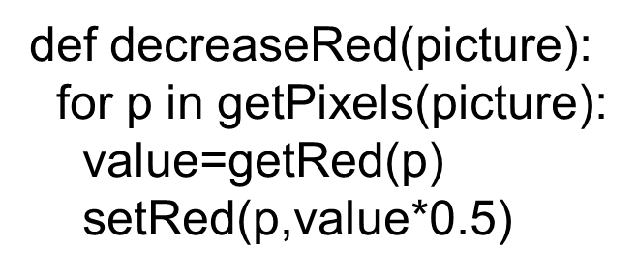
Think about What We Just Did
Did we change the program at all?
Did it work for all the different examples?
What was the input variable picture each time, then?
It was the value of whatever picture we provided as input!
Note: If you have a variable picture in your Command Area, that’s not the same as the picture in decreaseRed.

Slide 44
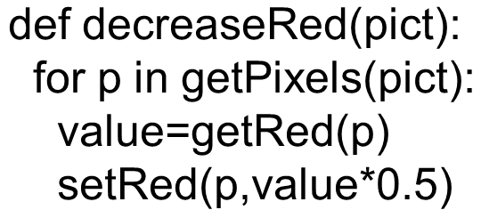
Read it as a Recipe
Recipe: To decrease the red
Ingredients: One picture, name it pict
Step 1: Get all the pixels of pict. For each pixel p in the pixels…
Step 2: Get the value of the red of pixel p, and set it to 50% of its original value

Slide 45
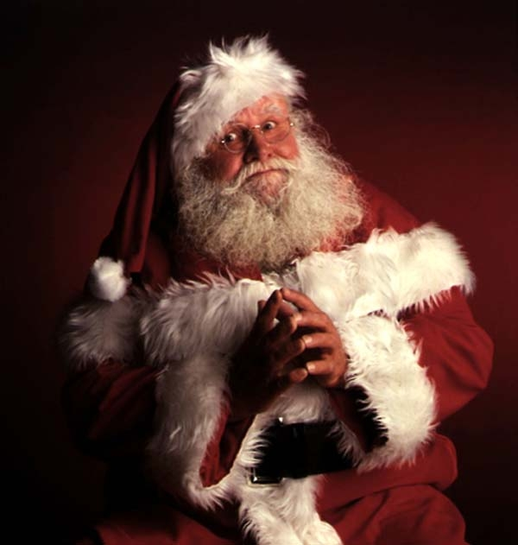
Let’s Use Something with Known Red to Manipulate: Santa Claus

Slide 46
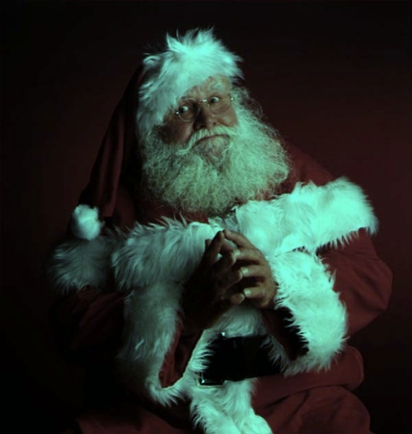
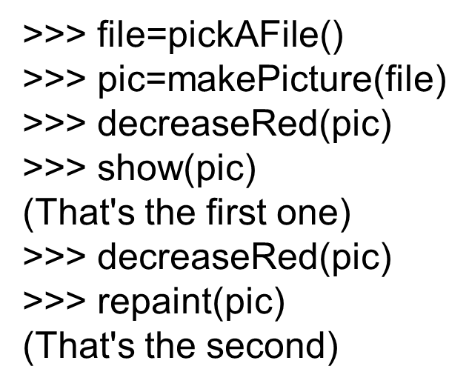

What if you Decrease Santa’s Red Again and Again and Again…?
You can also use: explore(pic) to open the MediaTools

Slide 47

If You Make Something You Like…
Like:
Windows: writePictureTo(myPicture,“C:/mediasources/my-picture.j p g”)
Mac O S: writePictureTo(myPicture,“/home/users/guzdial/mediasources/my-picture.j p g”)
Writes the picture out as a J P E G
Be sure to end your filename as “.j p g”!
If you don’t specify a full path, will be saved in the same directory as J E S.

Slide 48



Increasing Red
What happened here?!?
Remember that the limit for redness is 255.
If you go beyond 255, all kinds of weird things can happen if you have “Modulo” checked in Options.

Slide 49
How does IncreaseRed Differ From DecreaseRed?
Well, it does increase rather than decrease red, but other than that…
It takes the same input
It can also work for any picture
It’s a specification of a process that’ll work for any picture
There’s nothing specific to a specific picture here.

Slide 50


Clearing Blue
Again, this will work for any picture.
Try stepping through this one yourself!

Slide 51

How Many Bytes are in a 1024x768 Image?
(1) 786,432
(2) 2,359,296
(3) 18,874,368
(4) 1M P
Notes:
#2. #1 is number of pixels. #3 is number of bits. #4 is ½ -- it’s a 2Mp image.

Slide 52



Which One of the Below Pictures Was Generated from This Function (1 of 2)
Notes:
From upper left clockwise: 4, 3, 2, 1.
Answer here is #4.

Slide 53


Which One of the Below Pictures Was Generated from This Function (2 of 2)
Notes:
From upper left clockwise: 4, 3, 2, 1.
Answer here is #4.

Slide 54

Can We Combine These? Why Not!
How do we turn this beach scene into a sunset?
What happens at sunset?
At first, I tried increasing the red, but that made things like red specks in the sand REALLY prominent.
That can’t be how it really works
New Theory: As the sun sets, less blue and green is visible, which makes things look more red.

Slide 55


A Sunset-Generation Function

Slide 56




Lightening and Darkening an Image

Slide 57
Creating a Negative
Let’s think it through
R,G,B go from 0 to 255
Let’s say Red is 10. That’s very light red.
What’s the opposite? LOTS of Red!
The negative of that would be 245: 255-10
So, for each pixel, if we negate each color component in creating a new color, we negate the whole picture.

Slide 58


Recipe for Creating a Negative

Slide 59


Original, Negative, Negative-Negative

Slide 60

Converting to Greyscale (1 of 2)
We know that if red=green=blue, we get grey
But what value do we set all three to?
What we need is a value representing the darkness of the color, the luminance
There are lots of ways of getting it, but one way that works reasonably well is dirt simple—simply take the average:

Slide 61


Converting to Greyscale (2 of 2)

Slide 62
Can We Get Back Again? Nope
We’ve lost information
We no longer know what the ratios are between the reds, the greens, and the blues
We no longer know any particular value.

Slide 63
But That’s not Really the Best Greyscale
In reality, we don’t perceive red, green, and blue as equal in their amount of luminance: How bright (or non-bright) something is.
We tend to see blue as “darker” and red as “brighter”
Even if, physically, the same amount of light is coming off of each
Photoshop’s greyscale is very nice: Very similar to the way that our eye sees it
Black&White T V’s are also pretty good
Notes:
Around about here, I usually do greyScale() again, but using getRed() for all three levels, and sometimes, getBlue() as well. The Red one always looks too light, and the Blue one looks too dark, which helps to make this point. I also often ask students to guess what will happen before I run either. It's common for students to claim that the programs won't work, or that we won't be able to discern the original picture. It's a useful experiment to run.

Slide 64

Building a Better Greyscale
We’ll weight red, green, and blue based on how light we perceive them to be, based on laboratory experiments.

Slide 65

Comparing the Two Greyscales: Average on Left, Weighted on Right

Slide 66

Let’s Use a Black Cat to Compare

Slide 67


Average on Left, Weighted on Right

Slide 68

A Different Sunset-Generation Function
This one does the same thing as the earlier form.
It's easier to read and understand: “To make a sunset is to reduceBlue and reduceGreen.”
We use hierarchical decomposition to break down the problem.
This version is less inefficient, but that's okay.
Programs are written for people, not computers.

Slide 69
Let’s Talk about Functions
How can we reuse variable names like picture in both a function and in the Command Area?
Why do we write the functions like this? Would other ways be just as good?
Is there such a thing as a better or worse function?
Why don’t we just build in calls to pickAFile and makePicture?

Slide 70
One and Only One Thing
We write functions as we do to make them general and reusable
Programmers hate to have to re-write something they’ve written before
They write functions in a general way so that they can be used in many circumstances.
What makes a function general and thus reusable?
A reusable function does One and Only One Thing

Slide 71


Contrast These Two Programs
Yes, they do the exact same thing!
makeSunset(somepict) works the same in both cases

Slide 72

Observations on the New Makesunset
It’s okay to have more than one function in the same Program Area (and file)
makeSunset in this one is somewhat easier to read.
It’s clear what it does “reduceBlue” and “reduceGreen”
That’s important!
Programs are written for people, not computers!

Slide 73

Considering Variations
We can only do this because reduceBlue and reduceGreen, do one and only one thing.
If we put pickAFile and makePicture in them, we’d have to pick a file twice (better be the same file), make the picture—then save the picture so that the next one could get it!
Notes:
At this point, I start making modifications, and students start shouting out suggestions. I'll make a version of reduceBlue and reduceGreen with pickAFile and makePicture in it, and run it, and point out how it would have to work to make sure that the file gets passed correctly. There are usually lots of questions about whether we need the input “picture,” so I'll build it with and without that. An explicit example I try is:
def reduceBlue(picture):
picture = makePicture(pickAFile())
…
So that they can see that if you SET the placeholder variable, your function does nothing to the input.

Slide 74
Does Makesunset Do One and Only One Thing?
Yes, but it’s a higher-level, more abstract thing.
It’s built on lower-level one and only one thing
We call this hierarchical decomposition.
You have some thing that you want the computer to do?
Redefine that thing in terms of smaller things
Repeat until you know how to write the smaller things
Then write the larger things in terms of the smaller things.
Notes:
This argument really seems to work – I get lots of nods about “hierarchical decomposition” after this explanation.

Slide 75


Are all the Things Named Picture the Same?
What if we use this like this in the Command Area:
Notes:
In class, I explicitly call makeSunset(file) here, so that they can see what error arises. Then I walk through WHY it's an error.

Slide 76

I Want to Increase the Blue of Each Pixel by 25%. I Write This:
setBlue(pixel, 0.25 * b)
setBlue(pixel, 1.25 * b)
setBlue(pixel, 0.75 * b)
setBlue(pixel, 1.75 * b)
Notes:
#2

Slide 77

I Want to Increase the Red of Each Pixel by the Same Amount. I Write This
setRed(pixel, r - 50)
setRed(pixel, r / 50)
setRed(pixel, r * 50)
setRed(pixel, r + 50)
Notes:
#4

Slide 78

What Happens When We Use a Function
When we type in the Command Area makeSunset(picture)
Whatever object that is in the Command Area variable picture becomes the value of the placeholder (input) variable picture in
makeSunset’s picture is then passed as input to reduceBlue and reduceGreen, but their input variables are completely different from makeSunset’s picture.
For the life of the functions, they are the same values (picture objects)
Notes:
Make clear that the placeholder “picture” doesn't have to be there. I typically change to something like “fred” and “wilma” to point out that the name of the placeholder is arbitrary. We call it “picture” to make the program more readable.

Slide 79
Names Have Contexts
In natural language, the same word has different meanings depending on context.
I’m going to fly to Vegas.
Would you please swat that fly?
A function is its own context.
Input variables (placeholders) take on the value of the input values only for the life of the function
Only while it’s executing
Variables defined within a function also only exist within the context of that function
The context of a function is also called its scope

Slide 80
Input Variables are Placeholders
Think of the input variable as a placeholder
It takes the place of the input object
During the time that the function is executing, the placeholder variable stands for the input object.
When we modify the placeholder by changing its pixels with setRed, we actually change the input object.

Slide 81

Variables within Functions Stay within Functions
The variable value in decreaseRed is created within the scope of decreaseRed
That means that it only exists while decreseRed is executing
If we tried to print value after running decreaseRed, it would work ONLY if we already had a variable defined in the Command Area
The name value within decreaseRed doesn’t exist outside of that function
We call that a local variable
Notes:
I do print value here in the Command Area, to point out that it has no value.

Slide 82
Writing Real Functions
Functions in the mathematics sense take input and usually return output.
Like ord() or makePicture()
What if you create something inside a function that you do want to get back to the Command Area?
You can return it.
We’ll talk more about return later—that’s how functions output something

Slide 83

Consider These Two Functions
First, it’s perfectly okay to have multiple inputs to a function.
The new decreaseRed now takes an input of the multiplier for the red value.
decreaseRed(picture,0.5) would do the same thing
decreaseRed(picture,1.25) would increase red 25%

Slide 84

Names are Important
This function should probably be called changeRed because that’s what it does.
Is it more general? Yes.
But is it the one and only one thing that you need done?
If not, then it may be less understandable.
You can be too general
Notes:
This slide really seems to work to convey that the names are arbitrary, but they should be understandable.

Slide 85


Understandability Comes First
Consider these two functions below
They do the same thing!
The one on the right looks like the other increase/decrease functions we’ve written.
That may make it more understandable for you to write first.
But later, it doesn’t make much sense to you
“Why multiply by zero, when the result is always zero?!?”

Slide 86
Always Write the Program Understandable First
Write your functions so that you can understand them first
Get your program running
Then make them better
Make them more understandable to others
Set to zero rather than multiply by zero
Another programmer (or you in six months) may not remember or be thinking about increase/decrease functions
Make them more efficient
The new version of makeSunset takes twice as long as the first version, because it changes all the pixels twice

Slide 87

Specifying Pixels by Index: DecreaseRed

Slide 88

Just one and half of Picture DecreaseRed
Which half? Top/bottom? Left/right?
Try it!

Slide 89



Copy Top Half to Bottom Half

Slide 90









Consider This Program: Which Picture Below Did this Generate?
Notes:
#1

Slide 91


Mirroring

Slide 92

Given What We’ve Now Learned About Getpixels() and the Order of Pixels, Predict the Behavior of This Program
(1) Clears Red on Top Half
(2) Clears Red on Bottom Half
(3) Clears Red on Left Half
(4) Clears Red on Right Half
Notes:
#1

Slide 93

Copyright

